Slide 1
YOUTUBE – CHANNEL -ANALYSIS

Slide 2



GROUP -1- TEAM
Abhishek Singh
Piyush Gupta
Huzefa Sadikot
MS IN DATA SCIENCE
MS IN DATA SCIENCE
MS IN COMPUTER SCIENCE

Slide 3
CONTENT
Introduction
Problem Definition
Dataset Used- (Structured + Unstructured)
Python Notebook (Performing all 20 Essential Steps)
Visualizations
Connecting to Big Query
Conclusion

Slide 4
INTRODUCTION

Slide 5
Youtube has over 2.5 billion monthly active users, and it is the second largest social media/entertainment platform in the world only behind Facebook. Users upload over 500 hours of video content on YouTube every minute, making it a treasure trove of information. By analyzing the user behaviour on certain youtube channels(no of likes and comments, tags, video titles etc.), we can get insights into how viewers perceive the content, and what changes can be made to improve the content and hook them up for more watch hours.
With the onset of the COVID-19 pandemic and restrictions forcing people to stay at home, all the social platforms witnessed a massive spike in daily interaction and so did youtube viewing traffic increased proportionately, so much so that it had to reduce the default streaming quality to standard definition.
Such an extended viewing time generates exponential user base to be studied upon and revenue which is generated in turn. Hence, motivating many people to pursue YouTube as a career option.

Slide 6
PROBLEM DEFINITION

Slide 7
As per the aforementioned brief about youtube, today our project involves the analysis on youtube metrics. Youtube metrics hold a great variety of information for all the spectrum of content creators and general entertainment. Analysing these individual metrics will help us to have insights about the user behavior in a category of video, his likes and dislikes, his consumption of youtube content, and finally, his interaction with the forum in the form of comments and replies, if any.
Analysis with the help of google api key, specifically to study user interaction in a category of Data Science Tutorial channels on Youtube, we will analyze the key performance factors affecting the success of a youtube channel to have it as a blue print for our own youtube channel. After gathering the desired results this exploratory data analysis shall provide a foundation of varied watch and commenting patterns about audiences.

Slide 8
DATASET USED- (Structured + Unstructured)

Slide 9
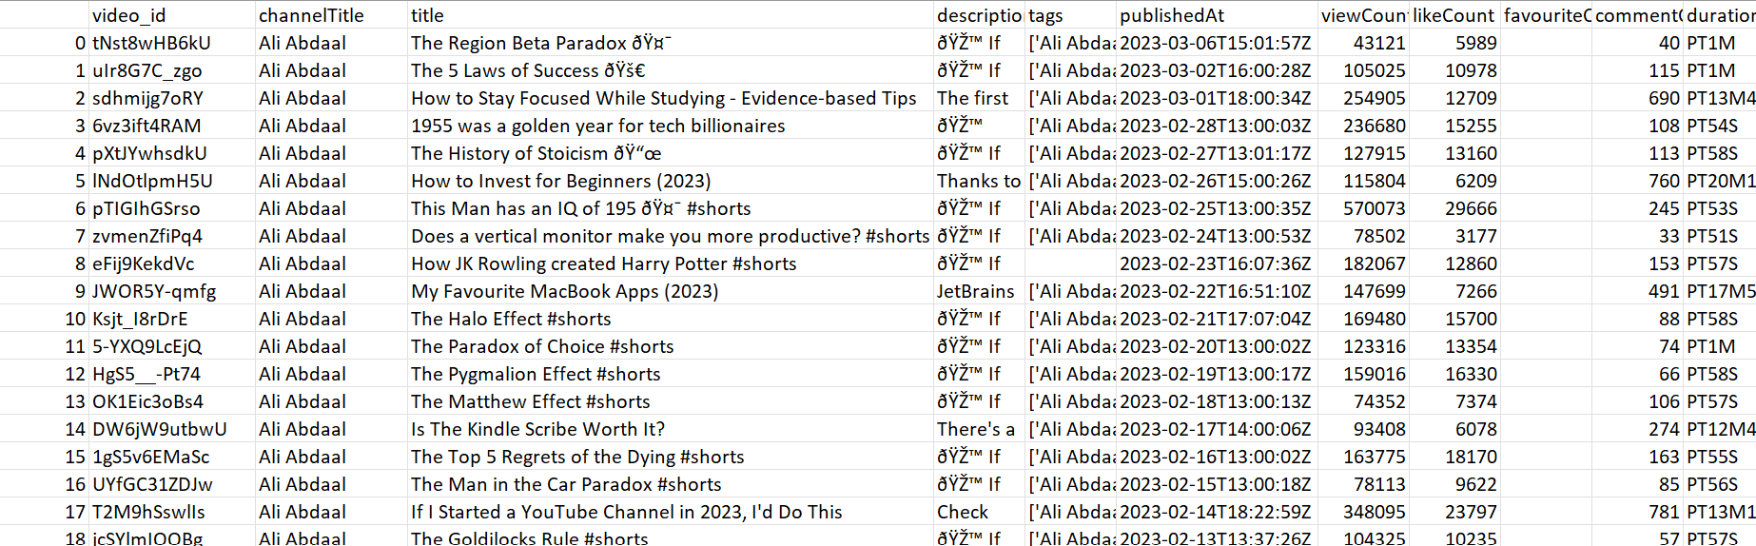
Structured Data
Get Channel Stats: Gets all the statistics og the particular channel like channel name, views, total videos
Get Video ID: Gets all the video id for a particular channel
Get_video_details: Gets details such as Channel Title, video title, view count, like count
We get statistics for each channel and then save as a csv then we combine all the csv to get a combined df

Slide 10
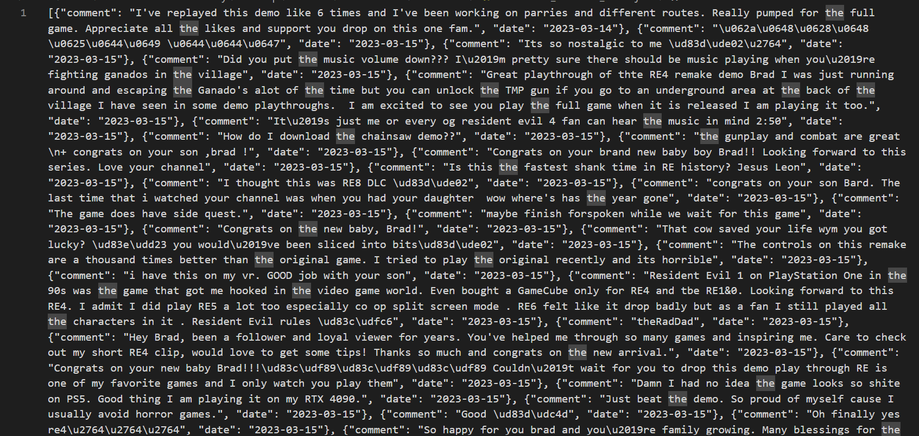
Unstructured Data
Using the above functions( for structured data) we save the resultant file as a json file
Then we use as a pd.read_json function to convert it into a df and perform further analysis
(**If worked on both structured and unstructured data we will receive extra credit : 10 points)

Slide 11
LIBRARIES USED

Slide 12
googleapiclient.discovery: Google API client library to access various Google APIs, such as Google Sheets or Google Drive.
dateutil.parser: A library for parsing human-readable date and time strings into Python datetime objects.
pandas: A powerful data manipulation and analysis library, providing data structures like DataFrames and Series.
IPython.display: A module for working with rich media representations, like JSON, in IPython environments (e.g. Jupyter notebooks).
glob: A module for finding all the pathnames matching a specified pattern according to the rules used by the Unix shell.
os: A module for interacting with the operating system, like reading from or writing to the file system.
Data visualization packages:
seaborn: A statistical data visualization library built on Matplotlib that provides a high-level interface for drawing informative and attractive graphs.
matplotlib.pyplot: A plotting library for creating static, animated, and interactive visualizations in Python.
matplotlib.ticker: A module for customizing tick locators and formatters in Matplotlib plots.

Slide 13
NLP:
nltk: A library for working with human language data (text), providing tools for text processing, classification, tokenization, stemming, tagging, and parsing.
nltk.corpus.stopwords: A module containing a list of common words that can be filtered out when processing natural language data.
nltk.tokenize: A module for breaking up text into words, phrases, symbols, or other meaningful elements (tokens).
wordcloud: A library for creating word cloud visualizations from text data
Database:
google.cloud.bigquery: A client library for interacting with Google Big Query, a fully-managed, serverless data warehouse.
google.oauth2.service_account: A module for managing service account-based authentication for Google APIs.
Unstructured:
numpy: A library for working with numerical data, supporting arrays, matrices, and various mathematical functions.

Slide 14
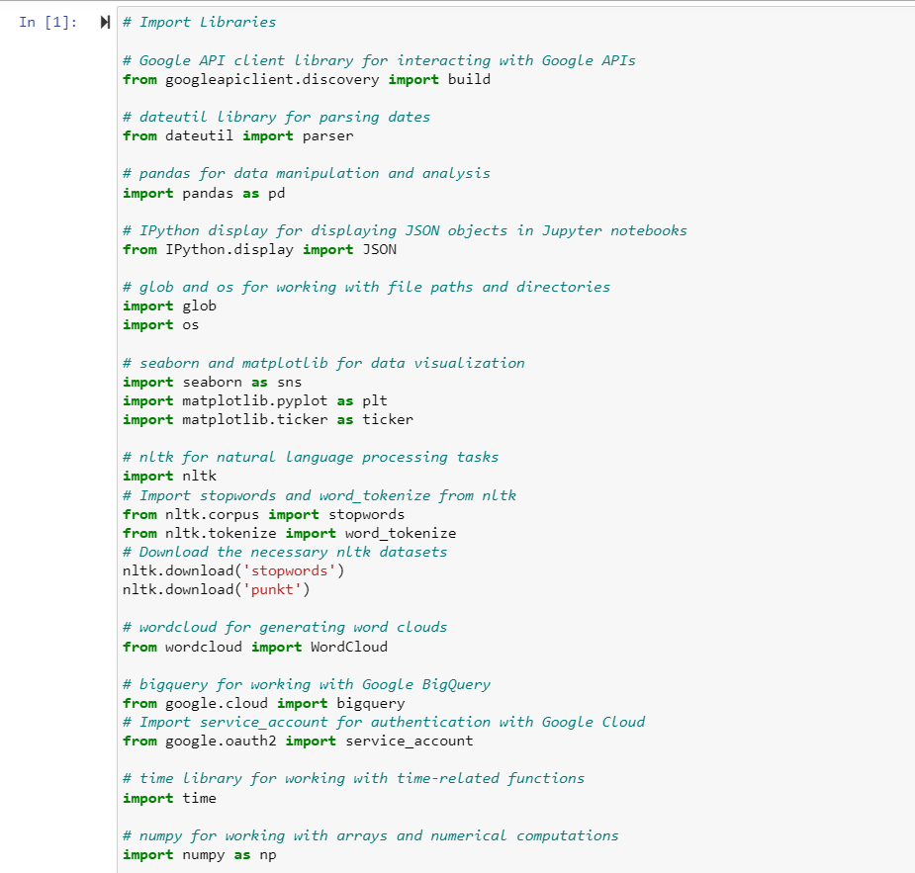

Slide 15
Python Notebook (Performing all 20 Essential Steps)

Slide 16
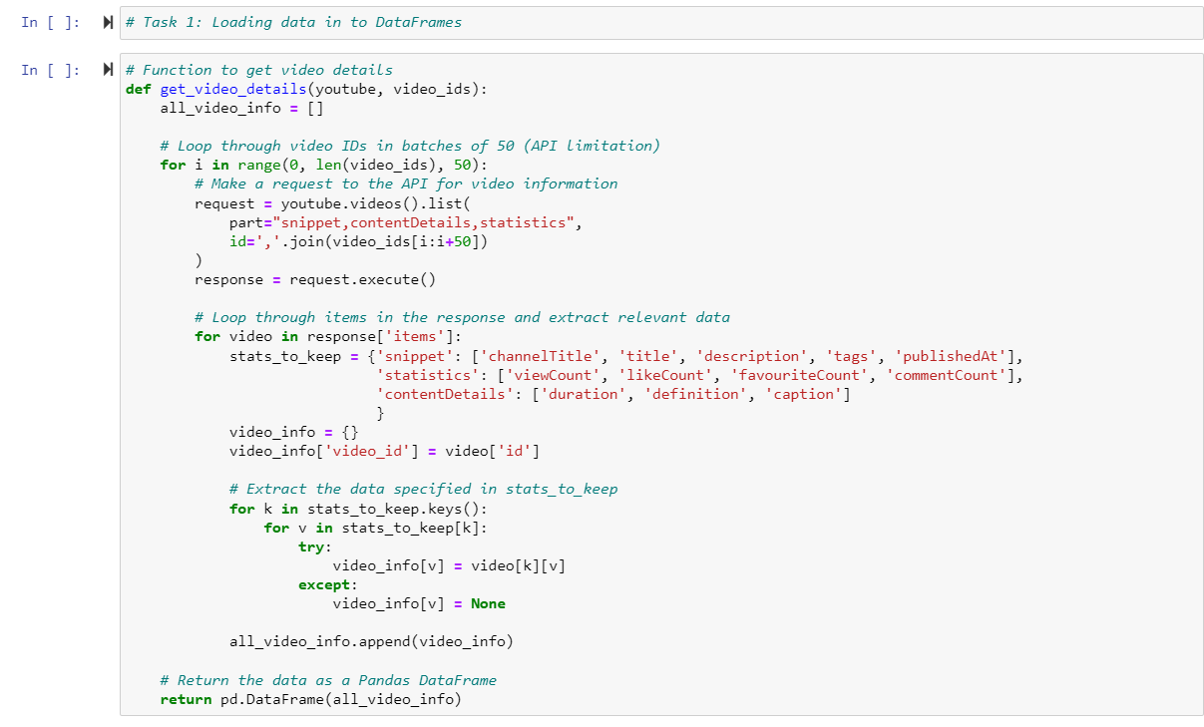
TASK 1:- Loading Data into Data Frames

Slide 17
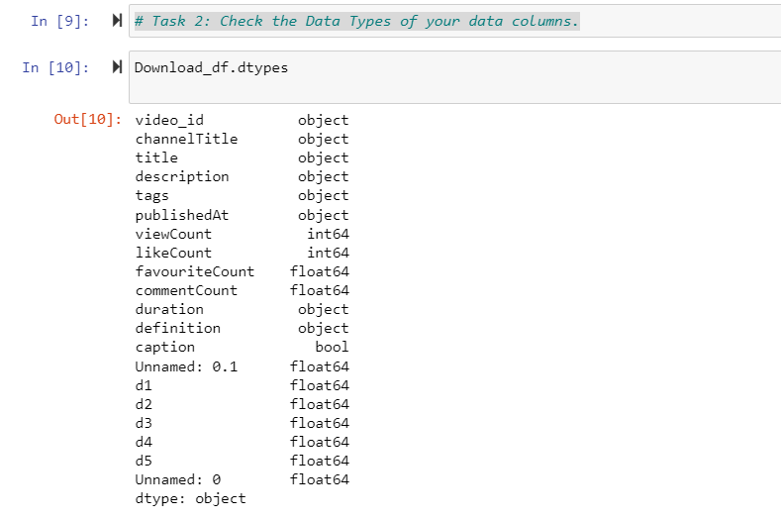
TASK 2:- Check the Data Types of your data columns

Slide 18
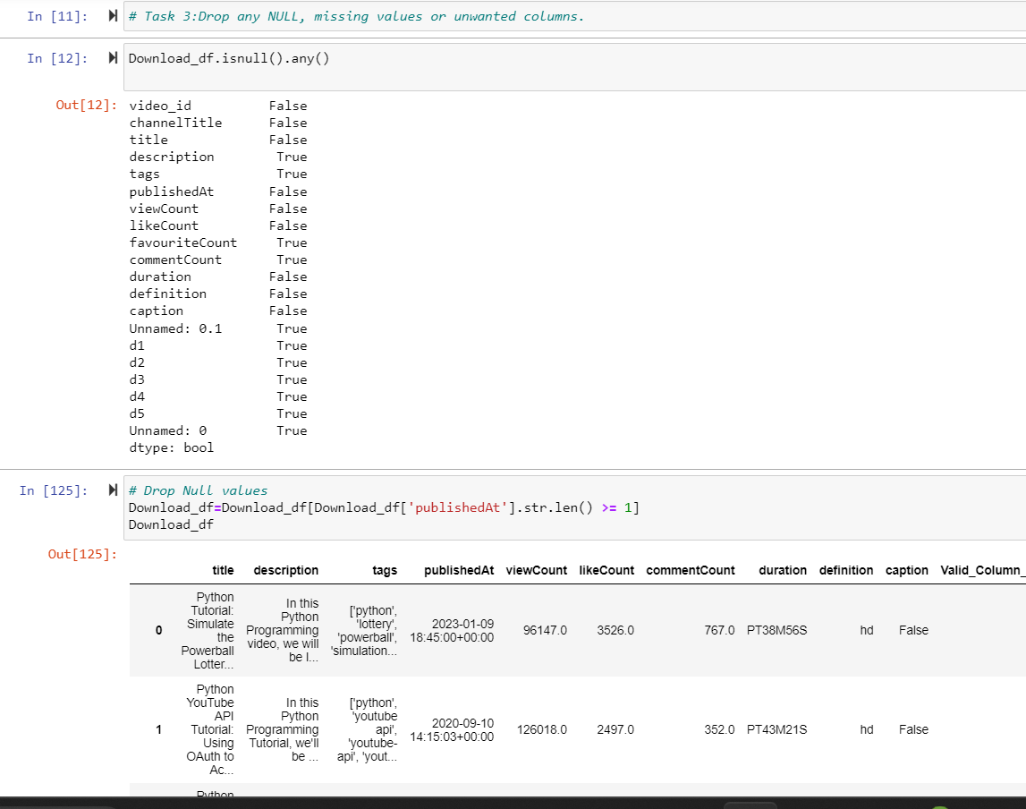
TASK 3:- Drop any NULL, missing values or unwanted columns

Slide 19
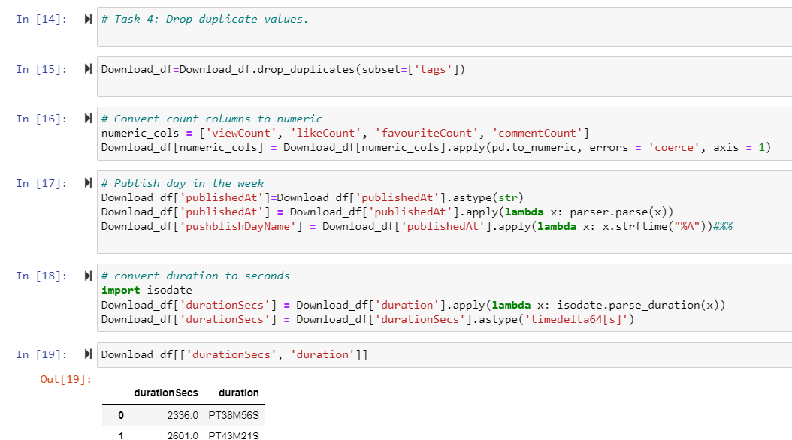
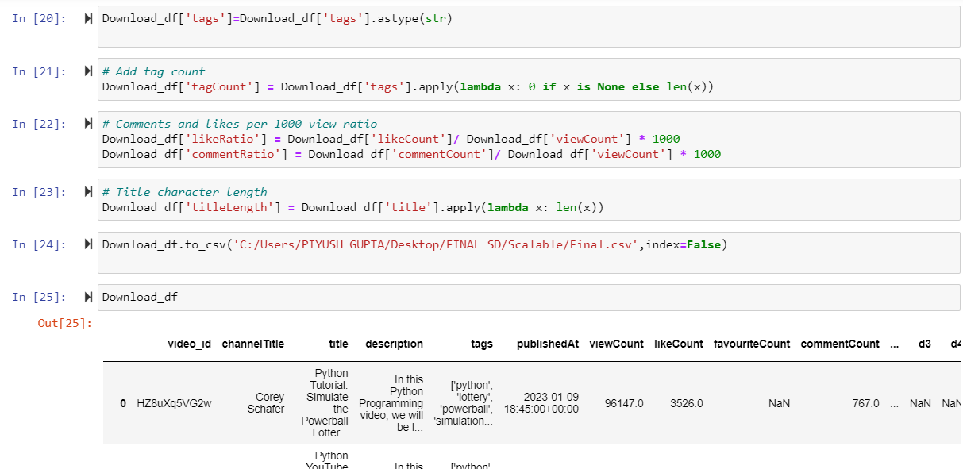
TASK 4:- Drop duplicate values

Slide 20
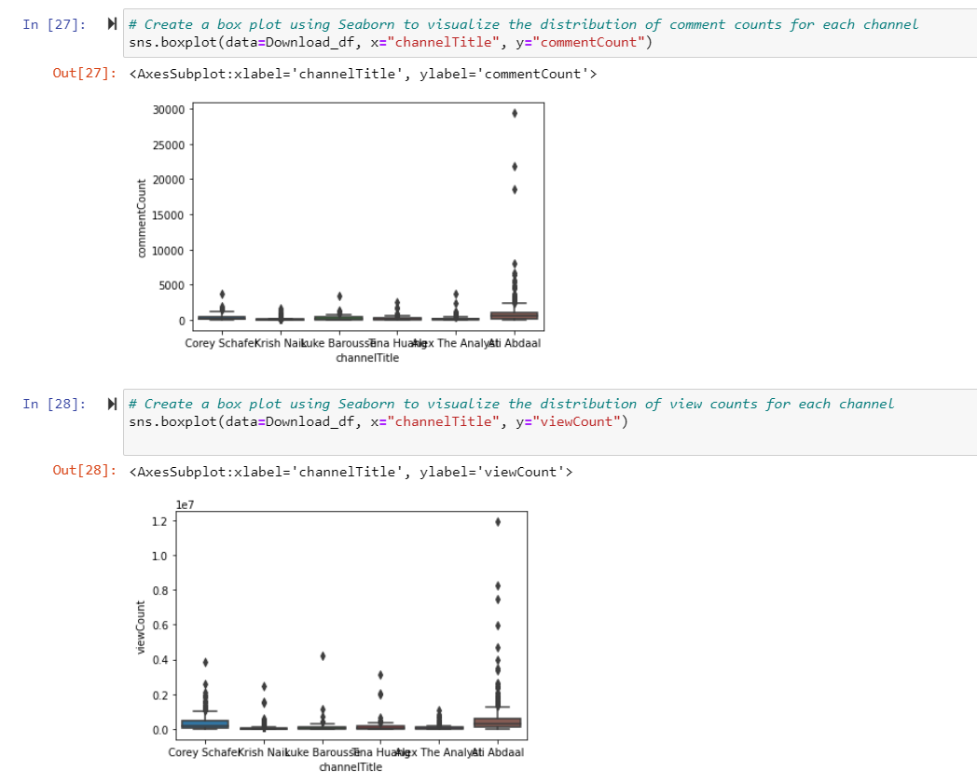
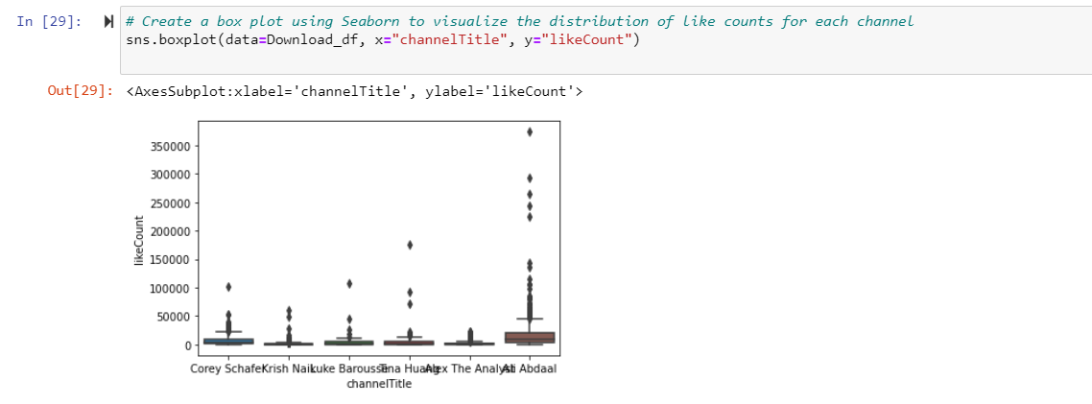
TASK 5:- Check for outliers using a box plot or histogram.

Slide 21
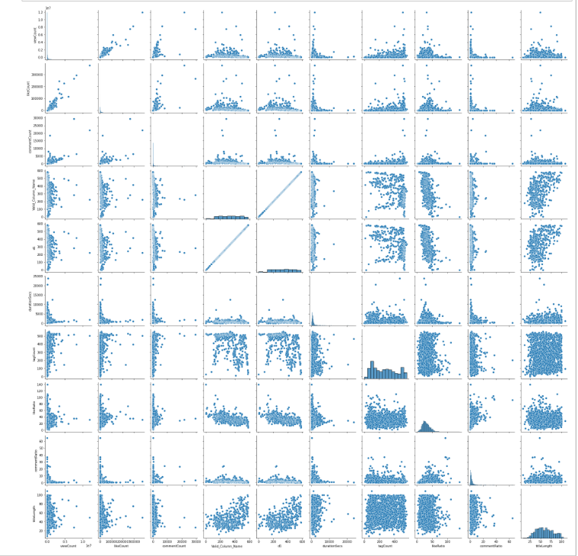
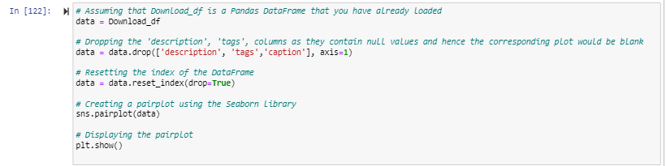
TASK 6:- Plot features against each other using a pair plot.

Slide 22
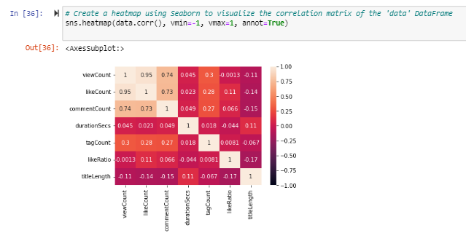
TASK 7:- Use a Heat Map for finding the correlation between the features(Feature to Feature).

Slide 23
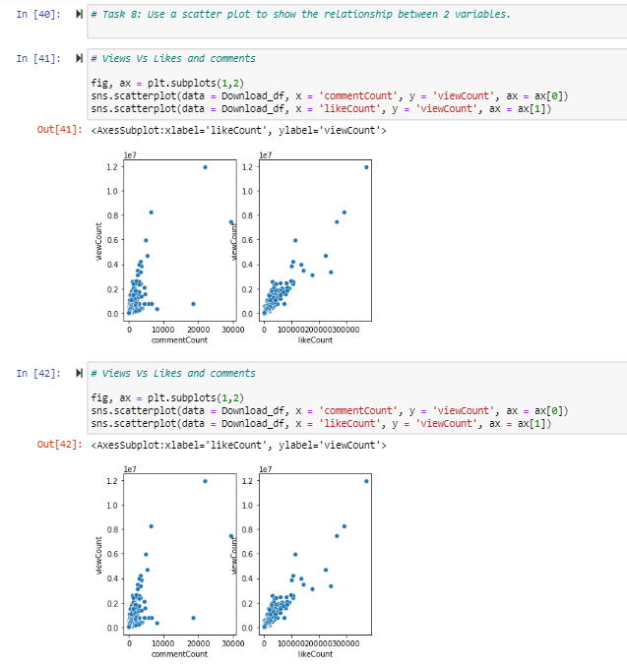
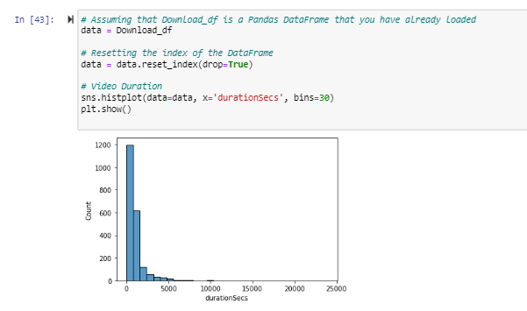
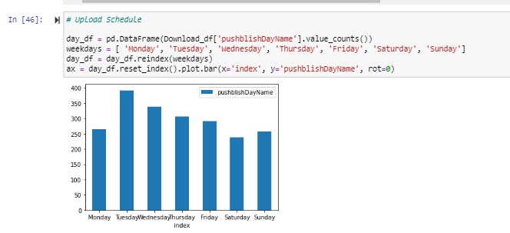
TASK 8:- Use a scatter plot to show the relationship between 2 variables.

Slide 24
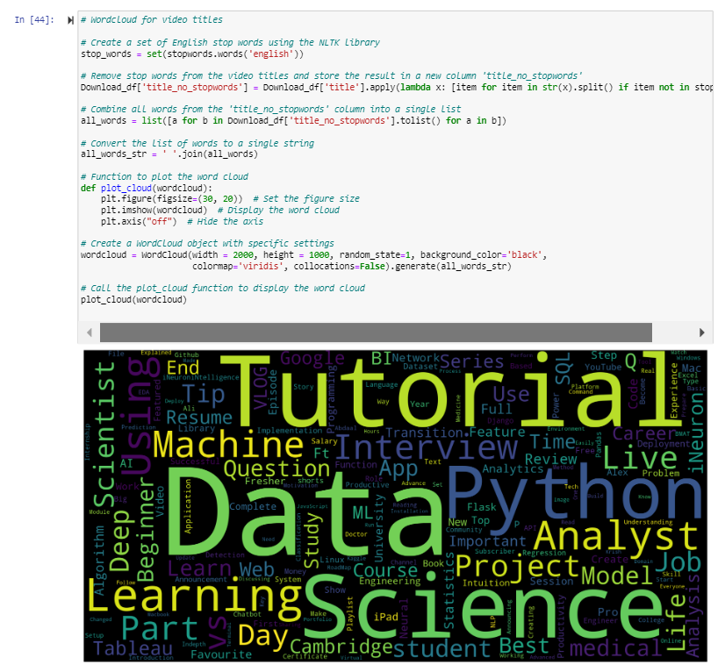

Slide 25
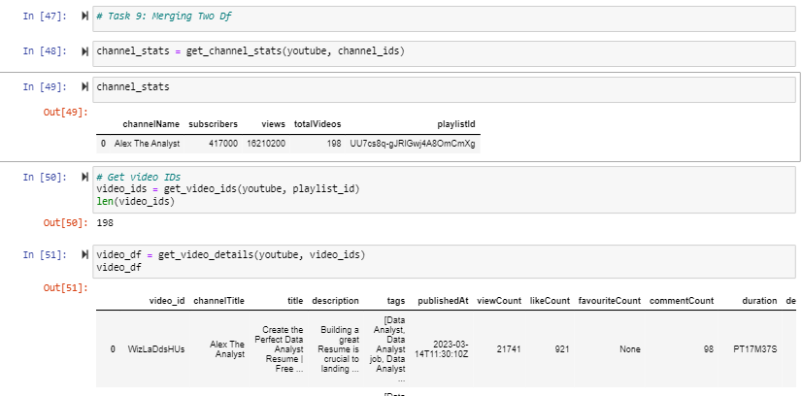
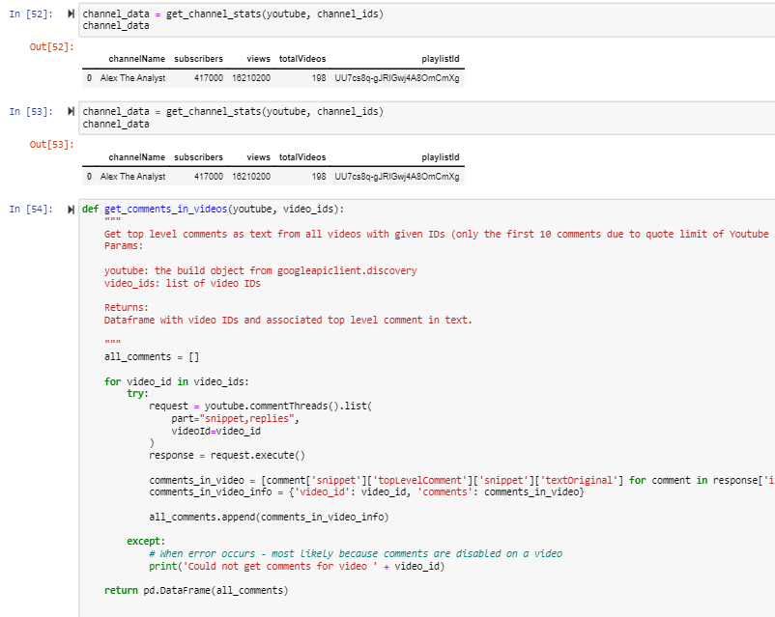
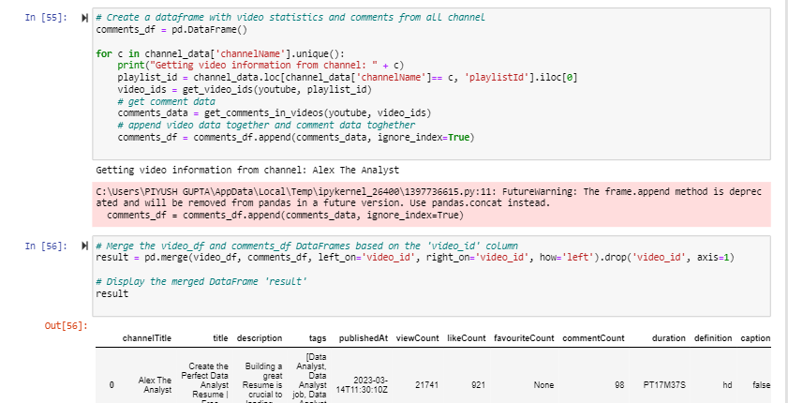
TASK 9:- Merging two Data Frames

Slide 26
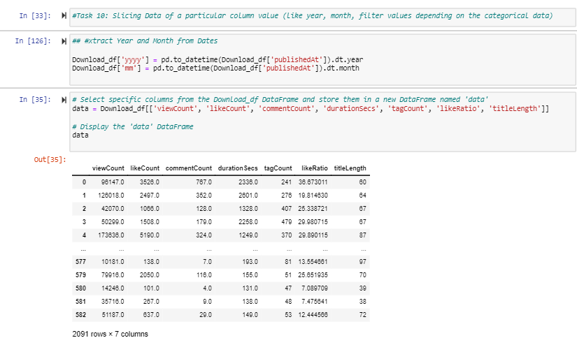
TASK 10:- Slicing Data of a particular column value (like year, month, filter values depending on the categorical data)

Slide 27
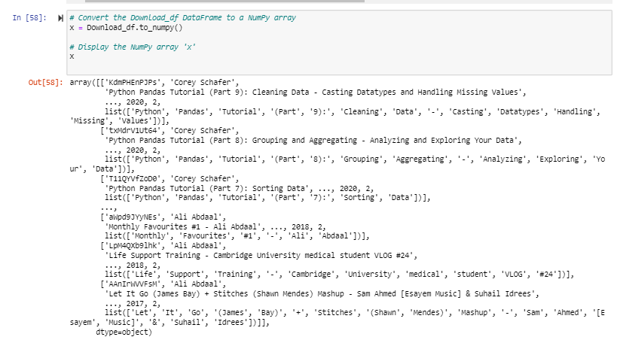
TASK 11:- Representing data in matrix form

Slide 28
TASK 12:- Upload data to Numerical Python (NumPy)

Slide 29
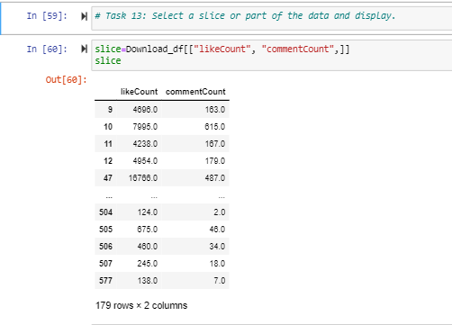
TASK 13:- Select a slice or part of the data and display

Slide 30
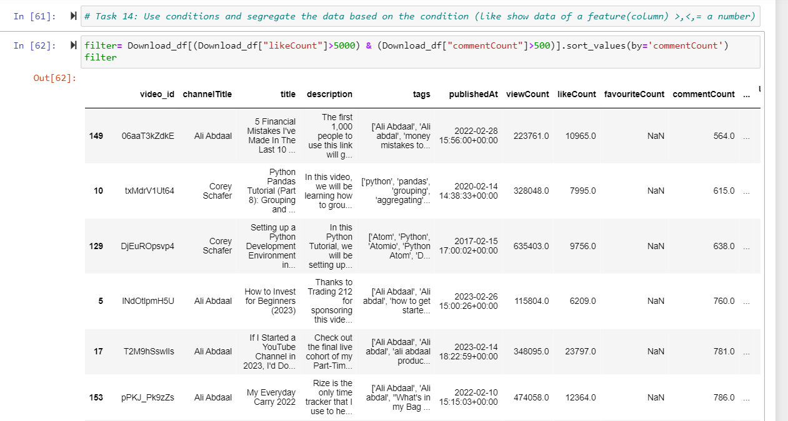
TASK 14:- Use conditions and segregate the data based on the condition (like show data of a feature(column) >,<,= a number)

Slide 31
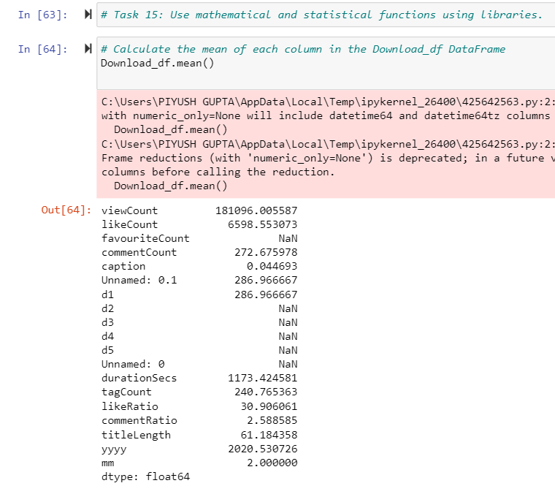
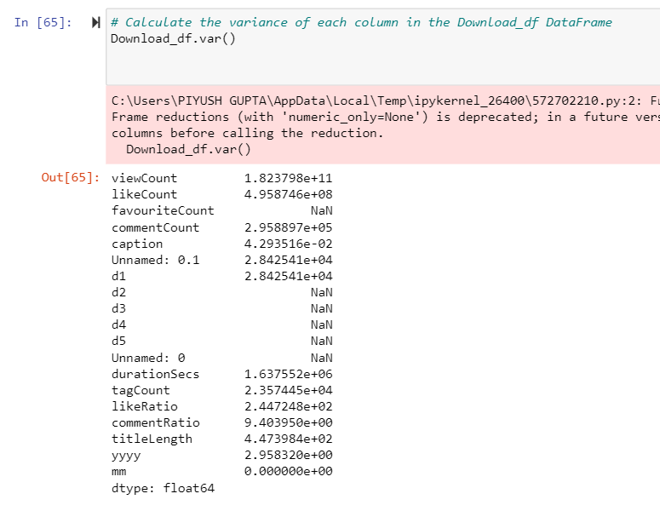
TASK 15:- Use mathematical and statistical functions using libraries

Slide 32
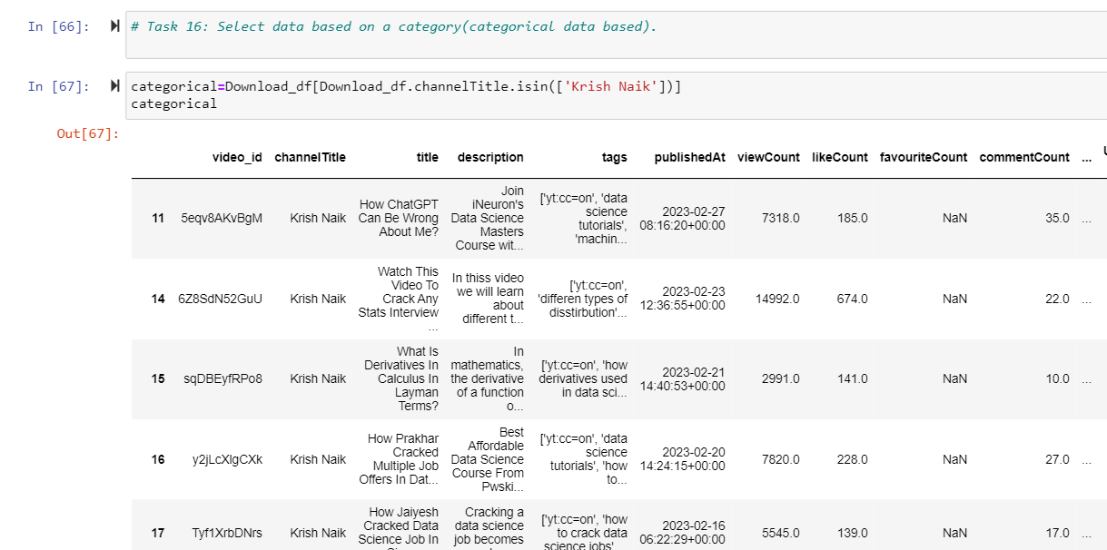
TASK 16:- Select data based on a category (categorical data based)

Slide 33
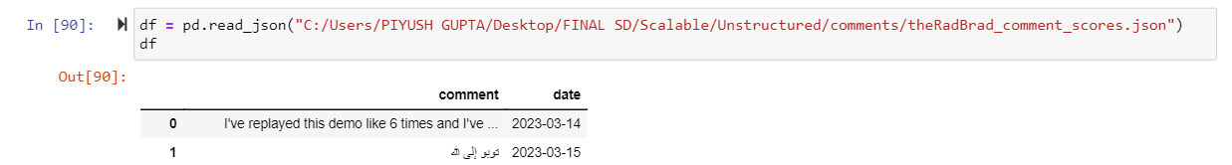
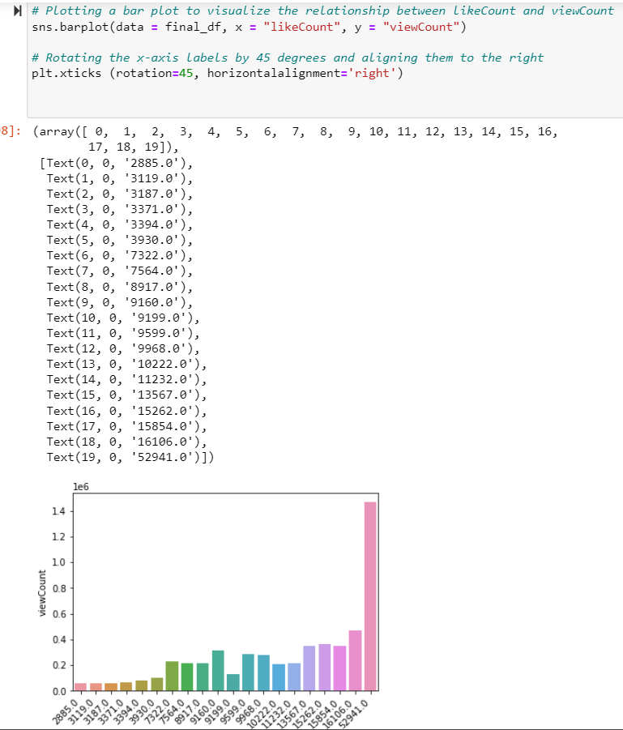
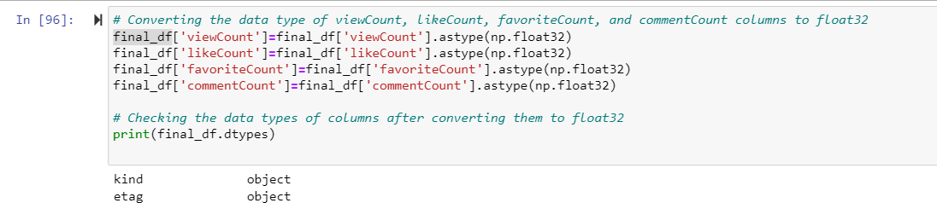
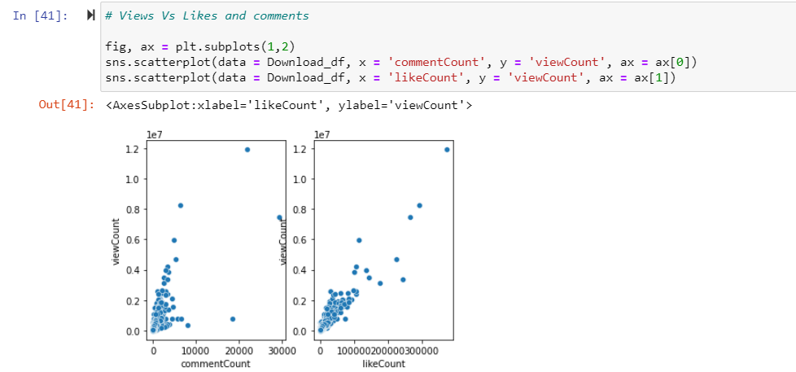
TASK 17:- Libraries expected to try(minimum 4 required): Pandas, Numpy, Seaborn, Matplotlib

Slide 34
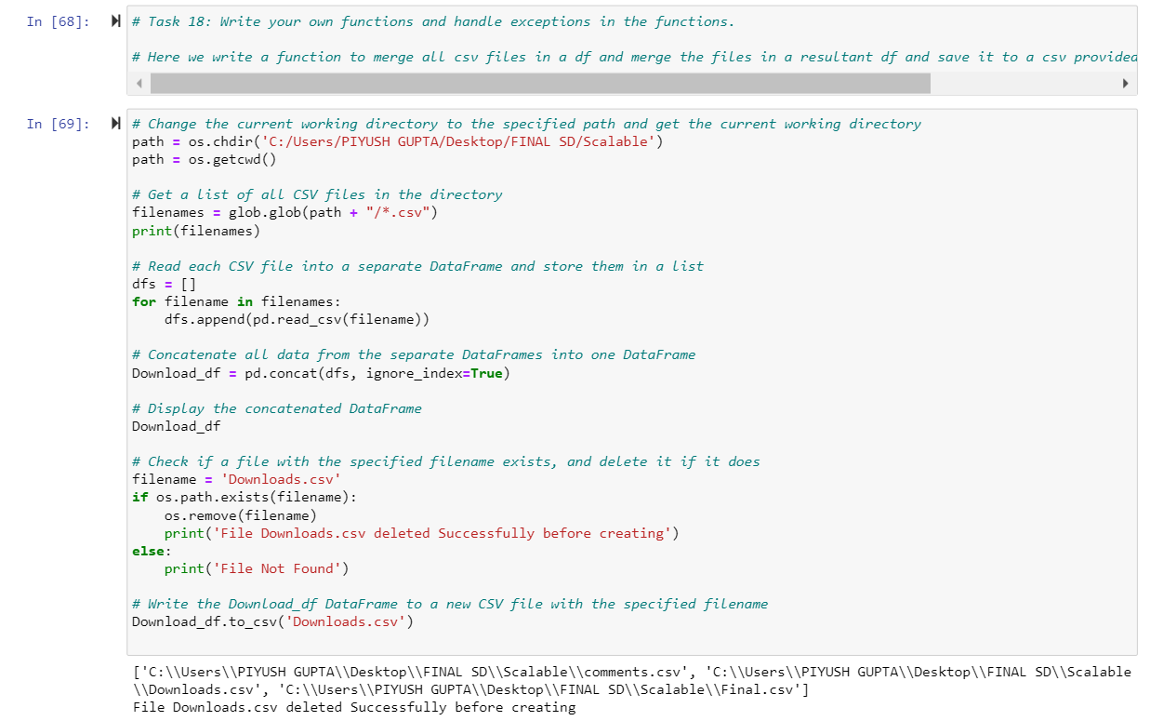
TASK 18:- Write your own functions and handle exceptions in the functions

Slide 35
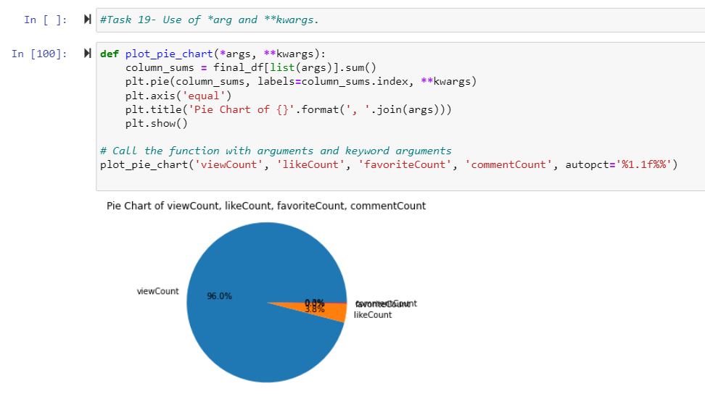
TASK 19:- Use of *arg and **kwargs

Slide 36
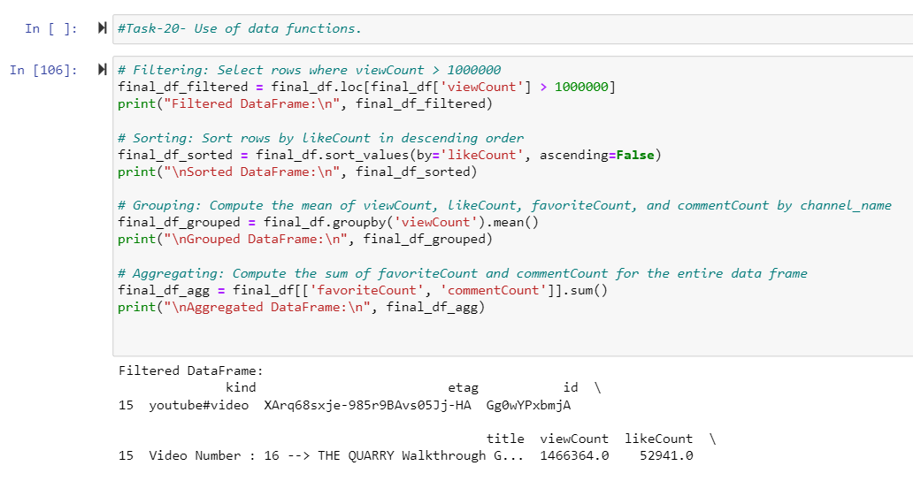
TASK 20:- Use of data functions

Slide 37
VISUALIZATIONS

Slide 38
Outliers using a box plot or histogram

Slide 39
Pair Plot

Slide 40
Scatter Plot to show the relationship between 2 variables

Slide 42
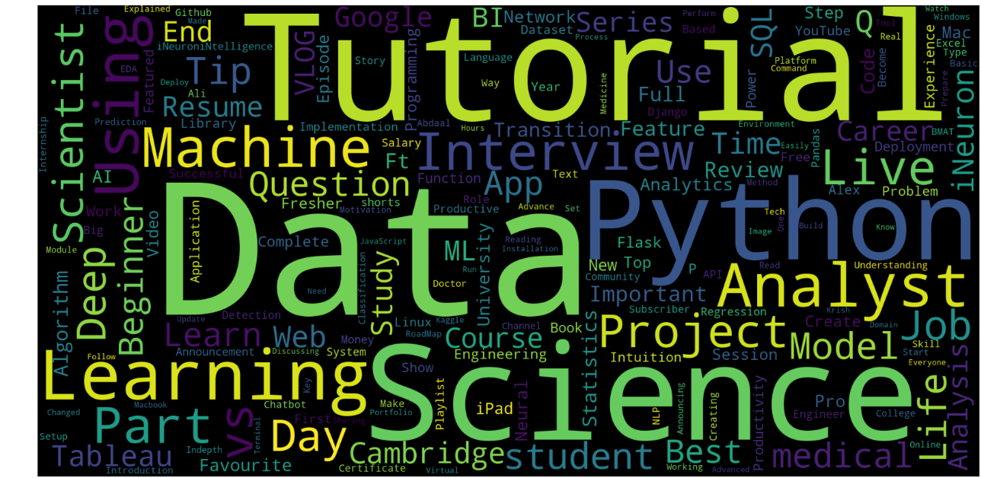
Word Cloud

Slide 43
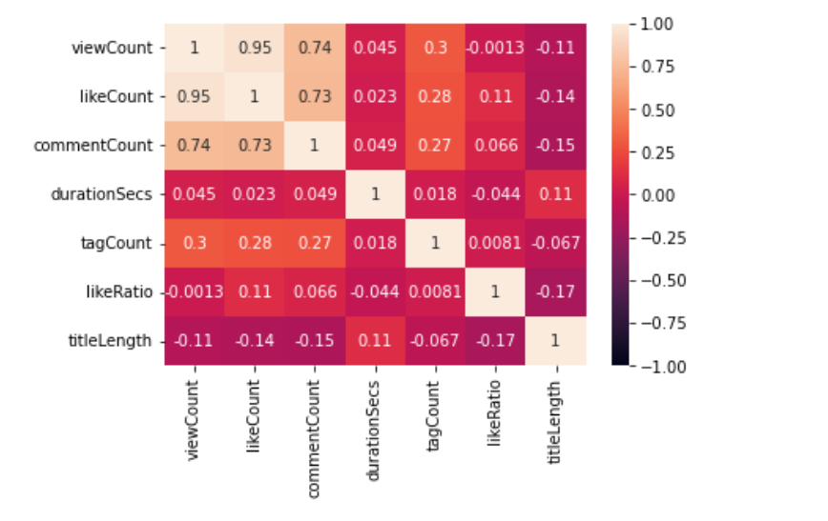
Heat Map

Slide 44
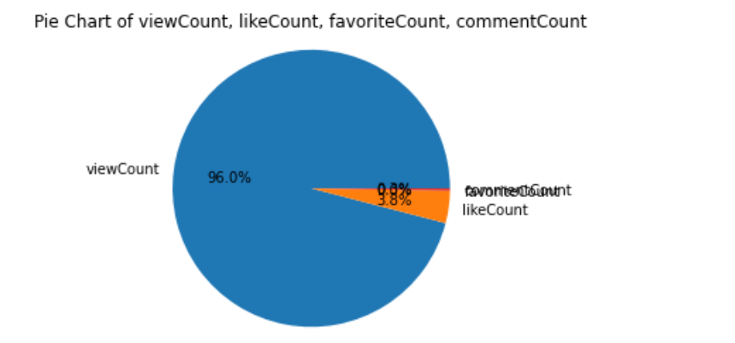
Pie Chart

Slide 45
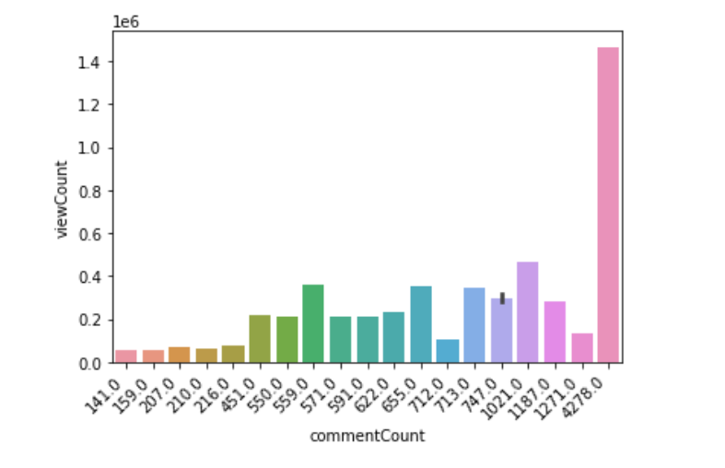
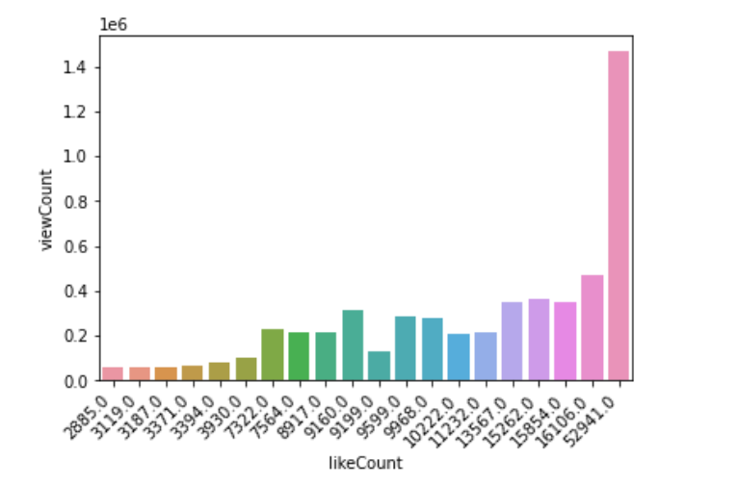
Bar Plot

Slide 46
Connecting to Big Query

Slide 47
Credentials
key_path= "opportune-balm-340813-cf5a94af05bc.json"
project_id="opportune-balm-340813"
dataset_id = "Youtube_Analytics"
table="Youtube Comments"
table_id="{}.{}.{}".format(project_id, dataset_id, table)
print("********* NAME OF TABLE IS", table_id)

Slide 48
Inserting Data into Table
def load_table_dataframe(key_path,project_id,table_id): credentials = service_account.Credentials.from_service_account_file( key_path, scopes=["https://www.googleapis.com/auth/cloud-platform"], ) # Construct a BigQuery client object. client = bigquery.Client(credentials=credentials, project=project_id) dataframe = Download_df job_config = bigquery.LoadJobConfig( write_disposition="WRITE_TRUNCATE") job = client.load_table_from_dataframe( dataframe, table_id, job_config=job_config ) job.result() data = client.get_table(table_id) return data data = load_table_dataframe(key_path,project_id, table_id)

Slide 49
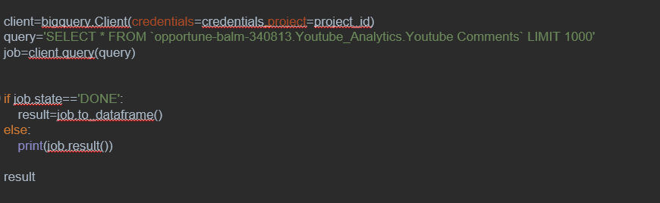
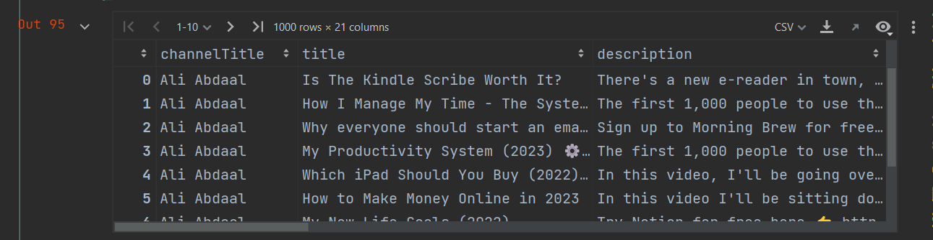
Running Queries

Slide 50
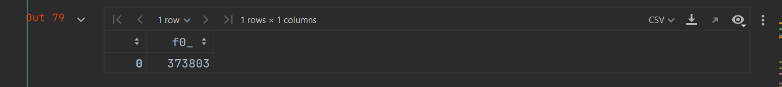
client=bigquery.Client(credentials=credentials,project=project_id)
query='Select MAX (likeCount) from `opportune-balm-340813.Youtube_Analytics.Youtube Comments`'
job=client.query(query)
if job.state=='DONE':
result=job.to_dataframe()
else:
print(job.result())
result

Slide 51
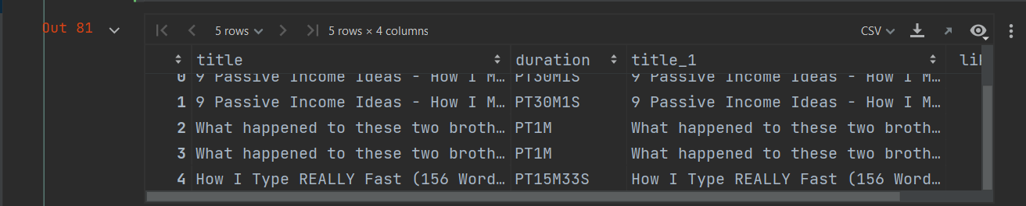
client = bigquery.Client(credentials=credentials, project=project_id)
query = 'select title,duration,title,likeCount from `opportune-balm-340813.Youtube_Analytics.Youtube Comments` order by likeCount desc limit 5;'
job = client.query(query)
if job.state == 'DONE':
result = job.to_dataframe()
else:
print(job.result())
result

Slide 52
CONCLUSION

Slide 53
In this project we have tried to determine what factors lead to a growth of a youtube channels
We have used a bigquery instead of sql as it is a datawarehouse system hosted on a cloud environment.. The cloud enviroment gives us the option of flexible scaling and also increased performance and speed as it gives us access to high throughput memory and storage
At the same time it is secure too
Another reason of using bigquery is that it is not admin managed and hence does not need a db admin as such

Slide 54


